Slide 1
TASC PINUPS
TASC PINUPS
TASC PINUPS
TASC PINUPS
TASC PINUPS
Test Link: http://gsfcuniversity.pythonanywhere.com
Test superuser Username: admin
Password: 123

Slide 2
TASC PINUPS
TASC PINUPS
TASC PINUPS
TASC PINUPS
TASC PINUPS
STUDENT REGISTRATION

Slide 3
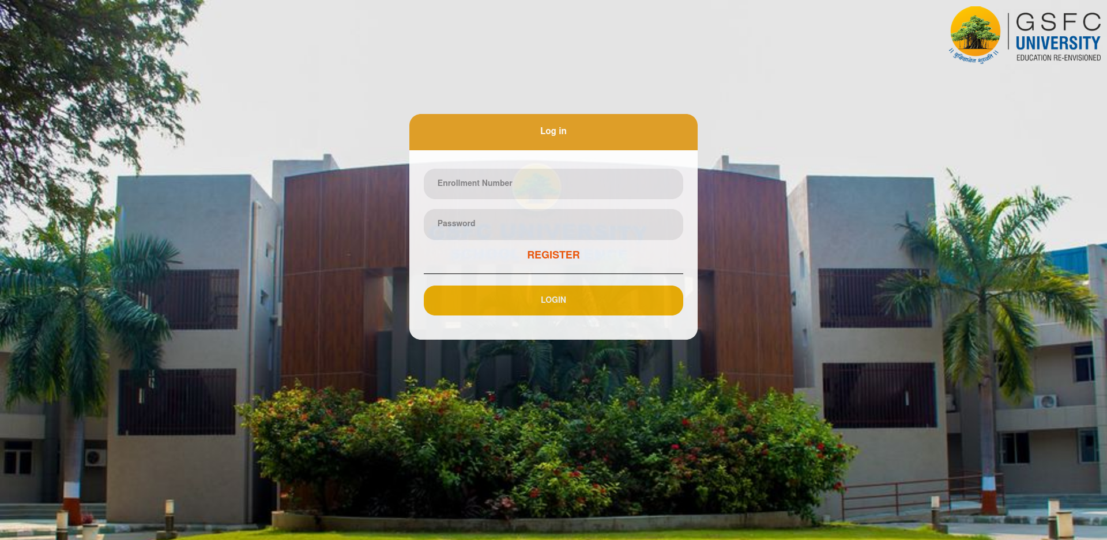
TASC PINUPS
TASC PINUPS
TASC PINUPS
TASC PINUPS
TASC PINUPS
Click to Register new Student to access portal

Slide 4
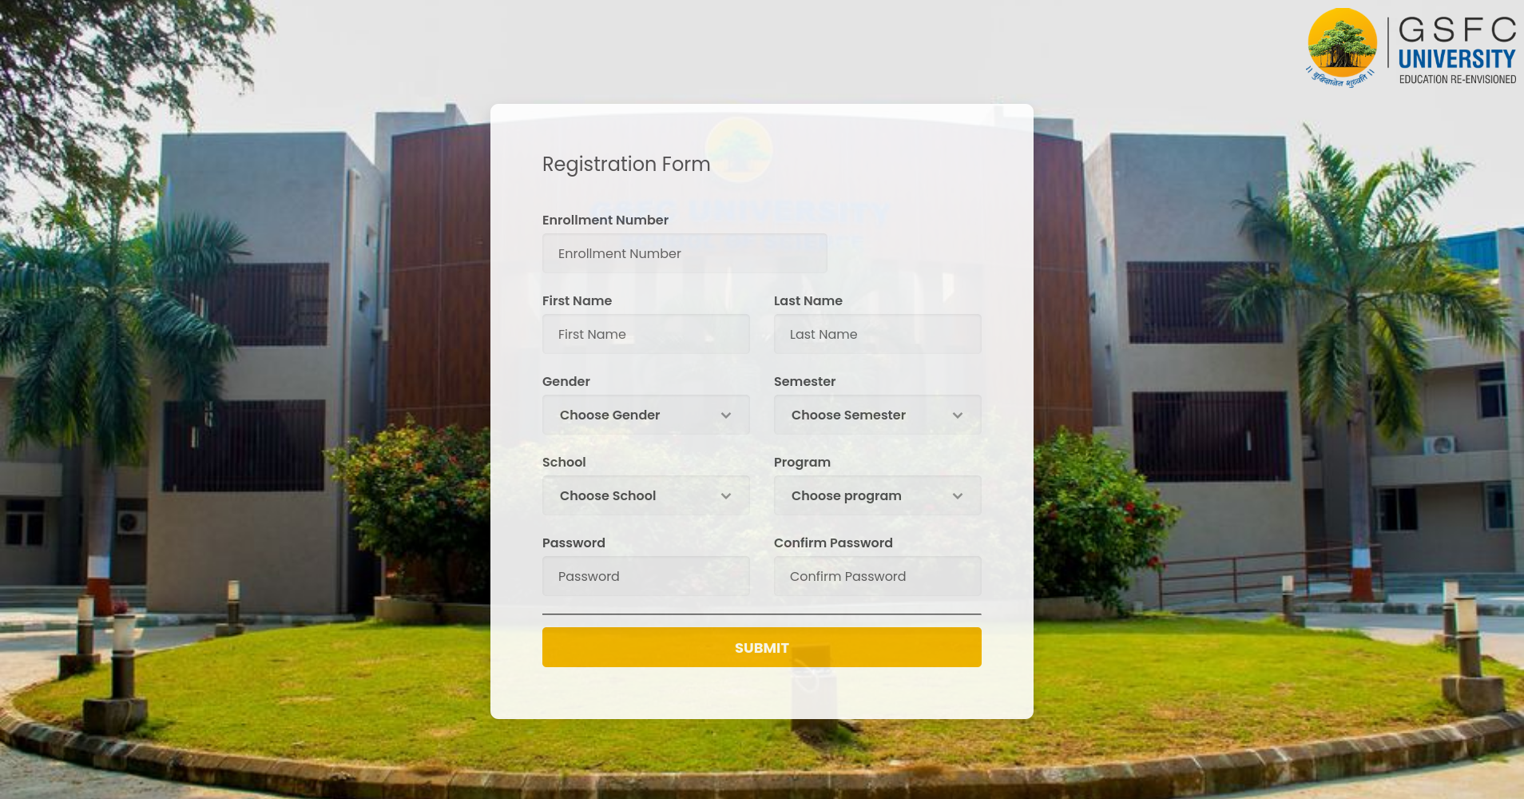
TASC PINUPS
TASC PINUPS
TASC PINUPS
TASC PINUPS
TASC PINUPS
Fill in your details and hit submit

Slide 5
TASC PINUPS
TASC PINUPS
TASC PINUPS
TASC PINUPS
TASC PINUPS
Login with your enrollment number and password

Slide 6
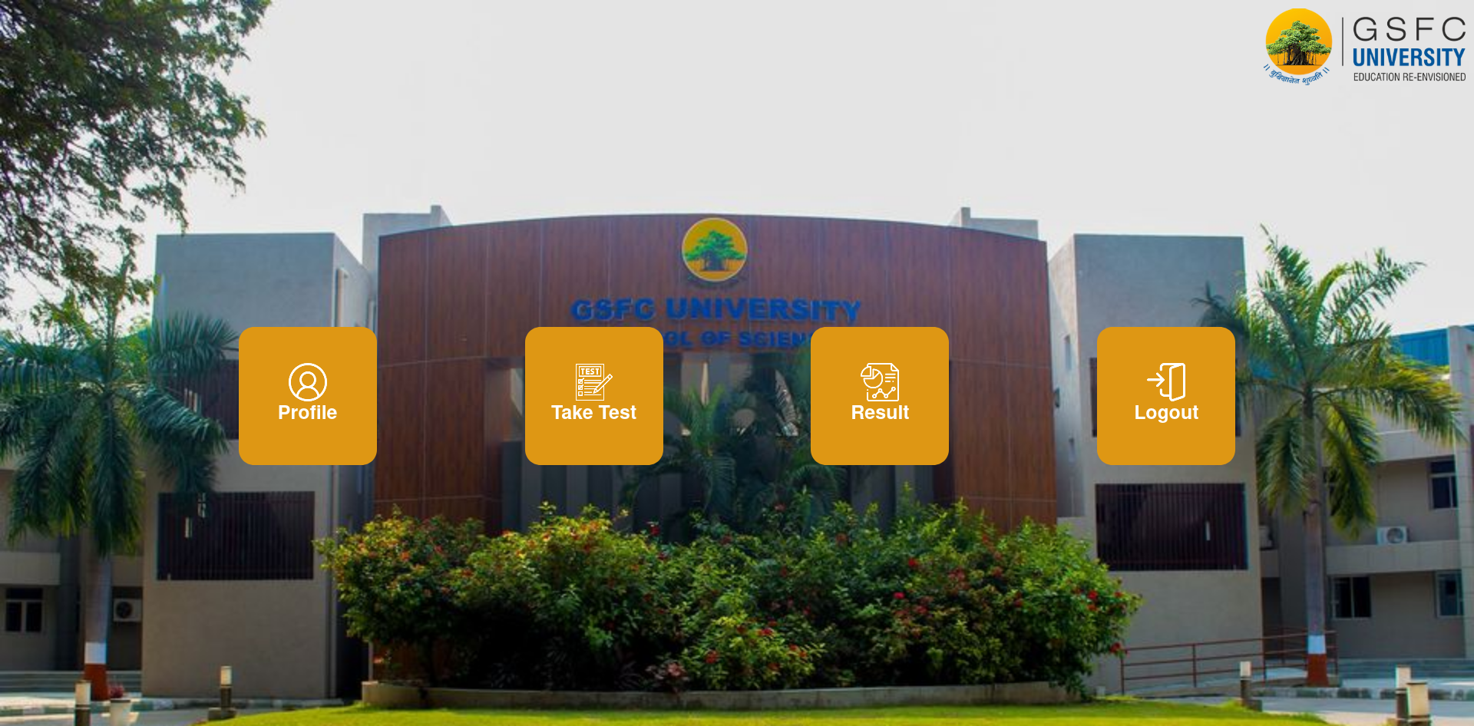
TASC PINUPS
TASC PINUPS
TASC PINUPS
TASC PINUPS
TASC PINUPS
Click on Take Test to start your assessment.
**Only authorized users will see this option

Slide 7
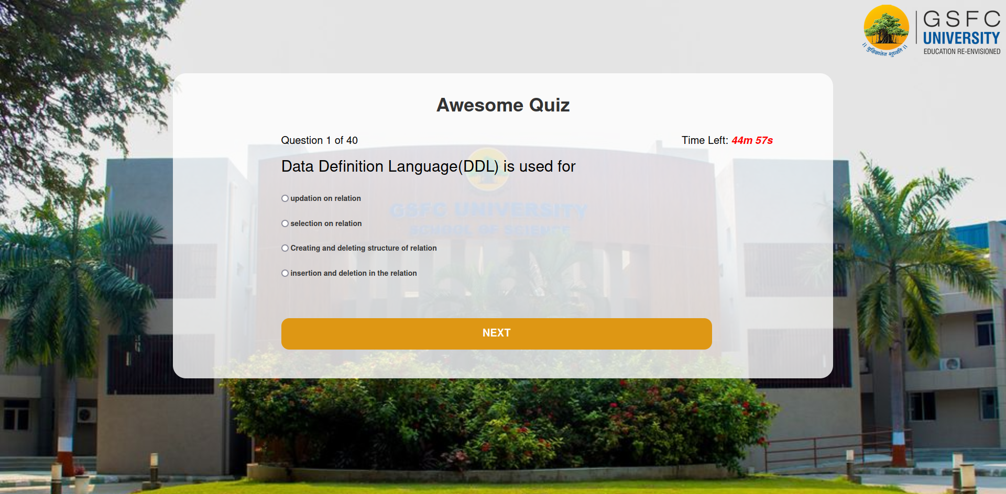
TASC PINUPS
TASC PINUPS
TASC PINUPS
TASC PINUPS
TASC PINUPS
Test Screen
Timer
Hit NEXT to submit your answer

